Slide 1
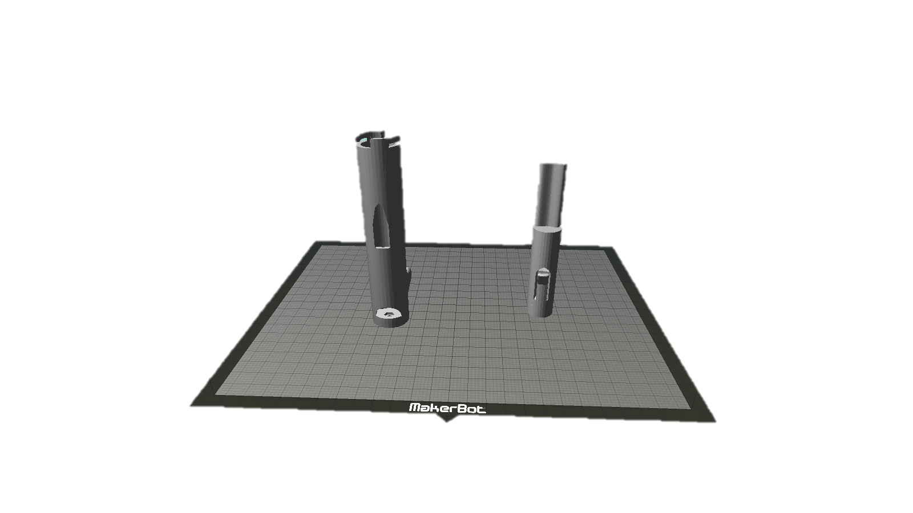
3D printed Micropipette

Slide 2
Cost
Commercial Micropipette
Test Micropipette
100-1000uL $371.75
10-100ul $384.58
BODY+Plunger Printed $124
Nut and bolt $0.30
Spring $0.79
3 mL Syringe $0.15
1mL syringe $0.15
Total with two syringes= $125.39

Slide 3
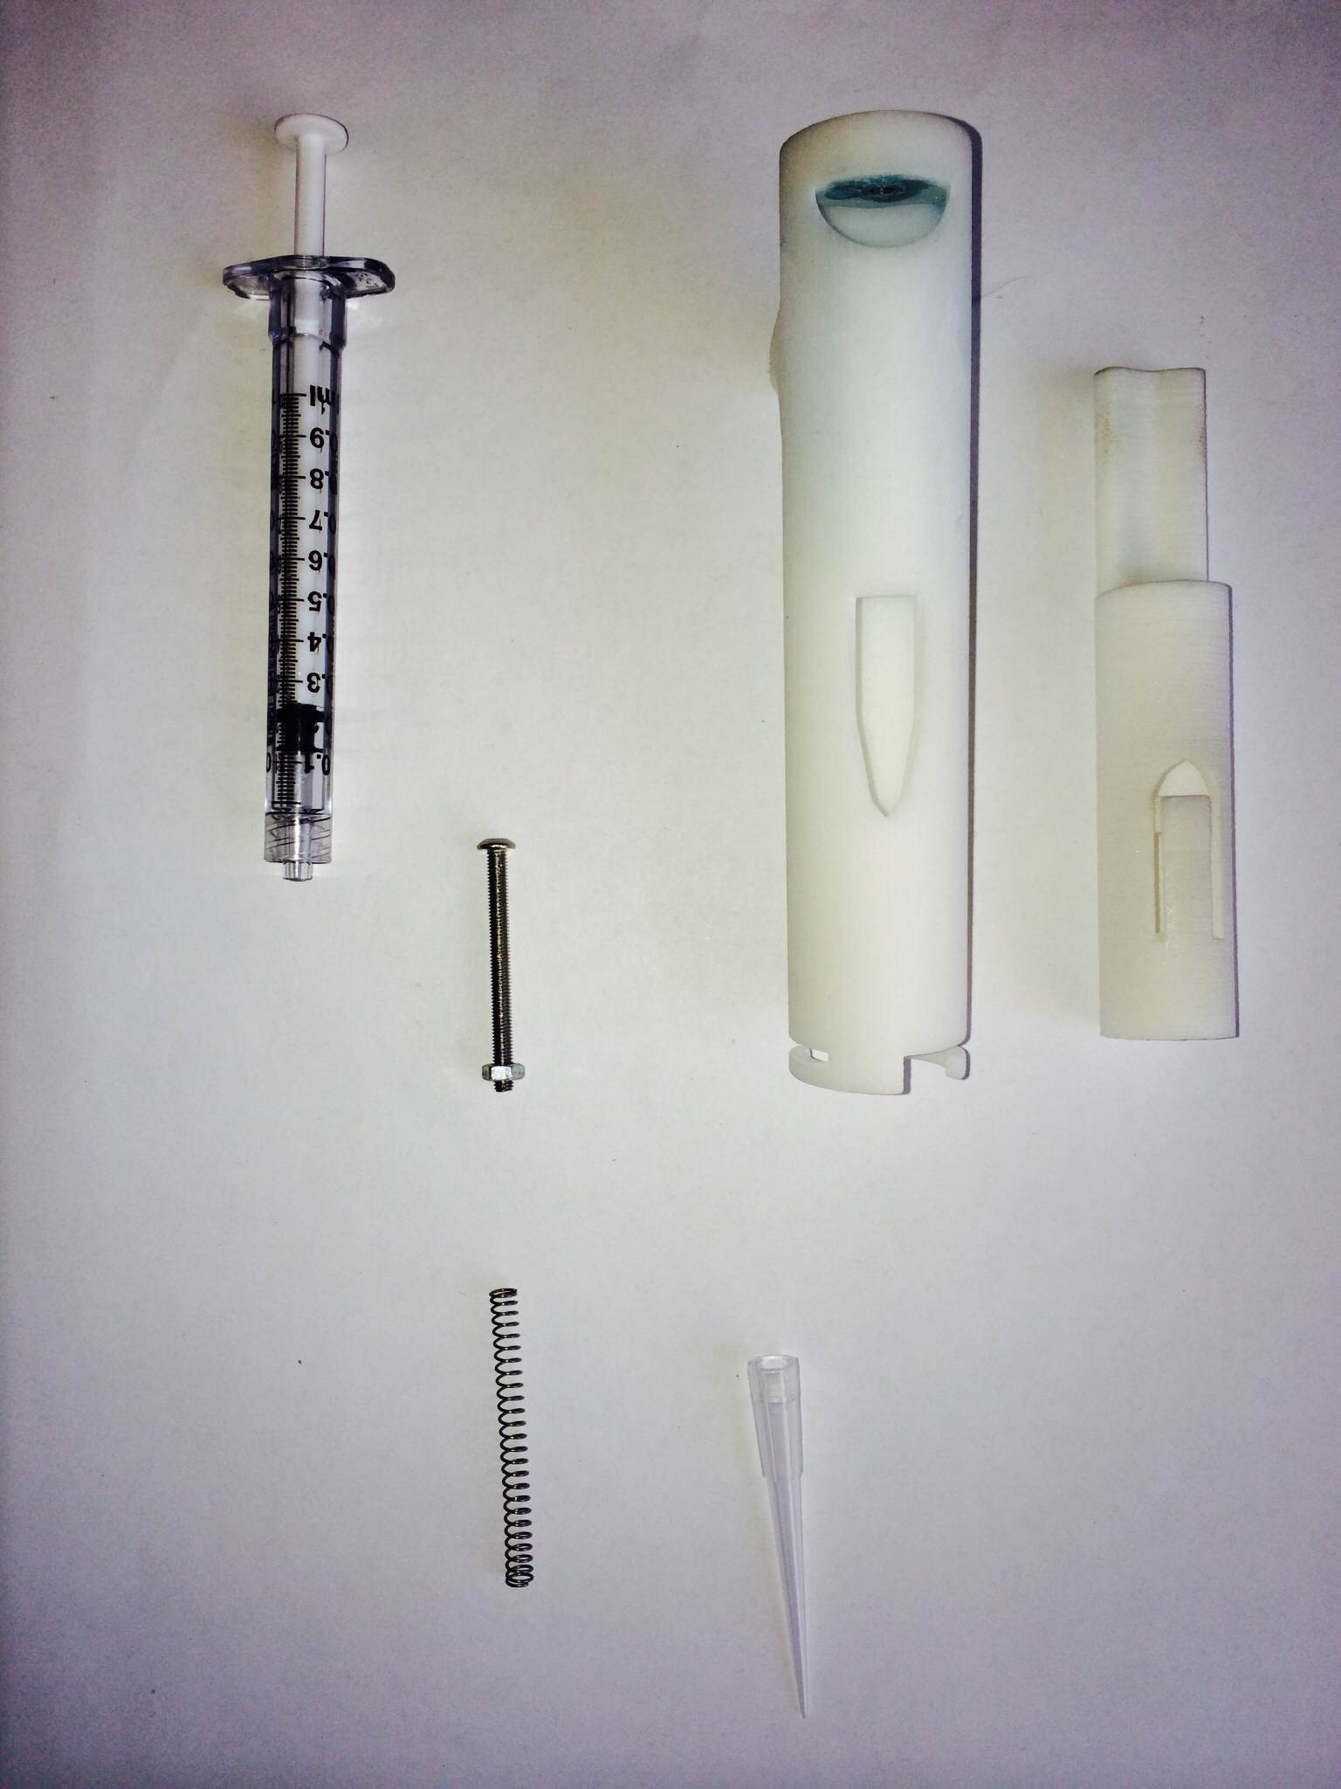
Parts
BODY
Plunger
Nut and Bolt
Spring
1mL Syringe

Slide 4
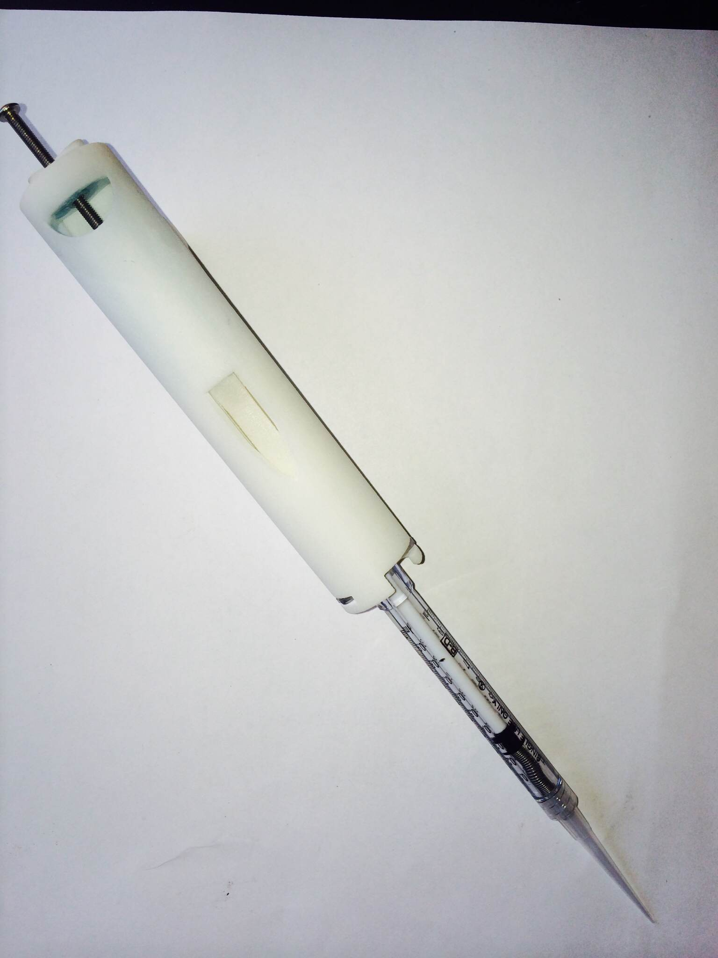
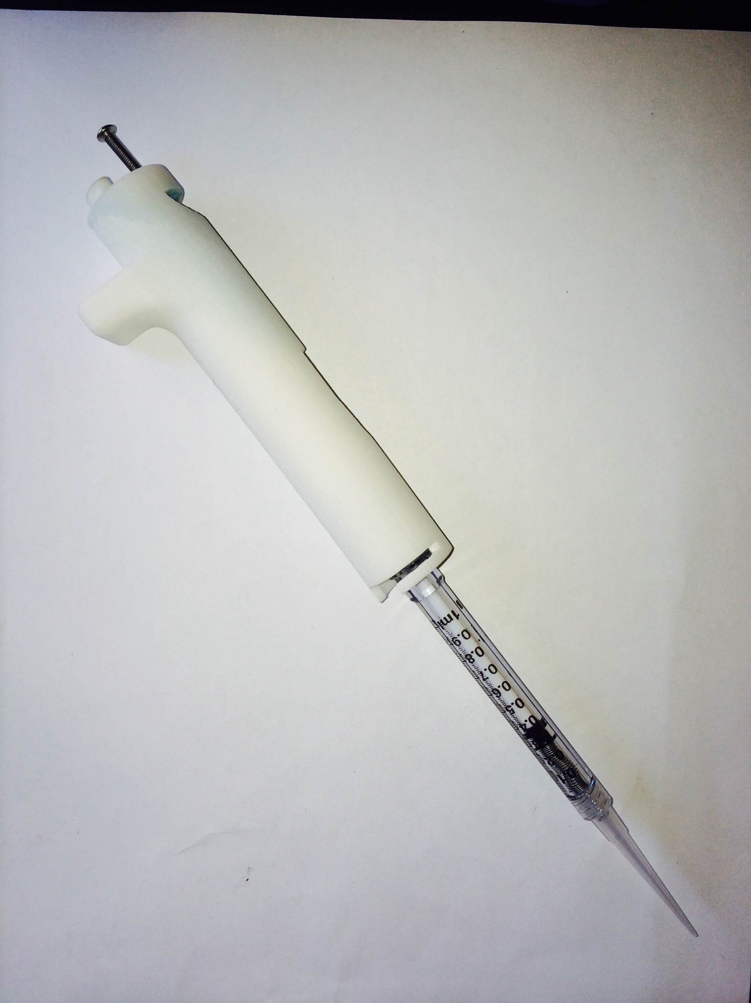
Assembled

Slide 5
Design

Slide 6
Specifications
With the 3mL Syringe Attached
Dispense up to 1 ml or 1000ul
Depending on the syringe:
Measure in increments of 100ul
With 1ml SYRINGE Attached
Dispense up to .35mL or 350uL
Measure in increments of 10uL

Slide 7
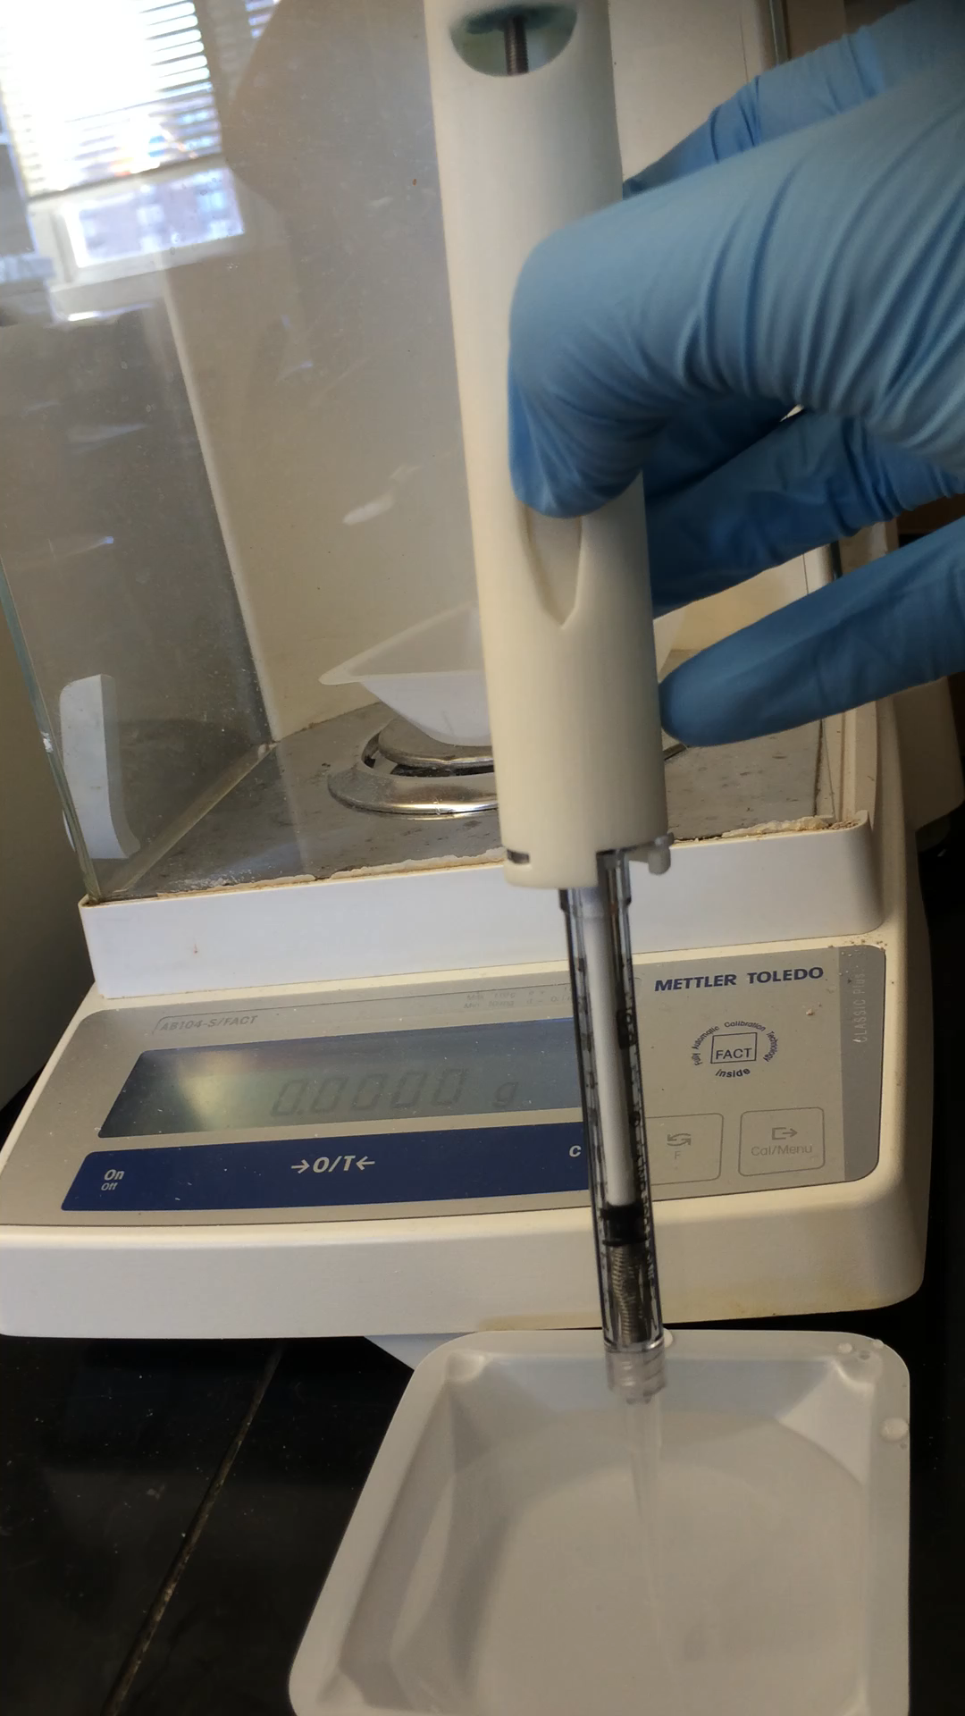
Demo:
Dispensing 200uL of water
Scale reads 0.2011g
Percent Error = 0.55%

Slide 8
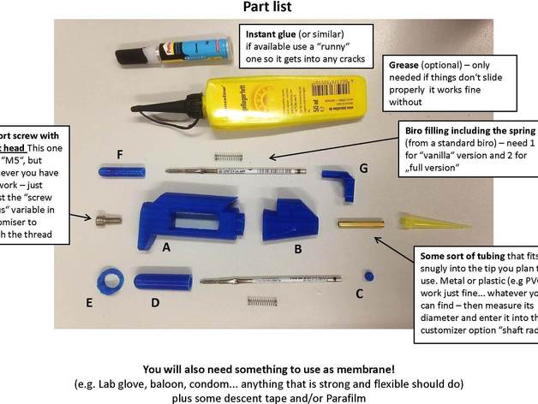
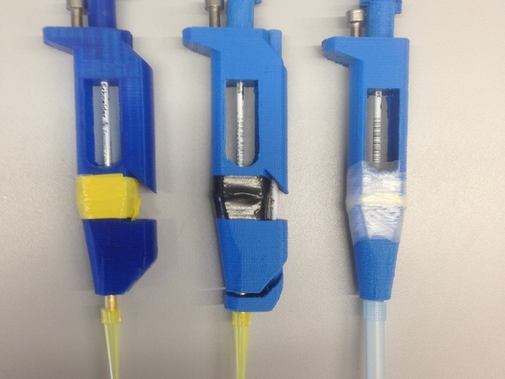
Competing Designs
Biropette: customizable, high precision pipette by tbaden on THingiverse

Slide 9
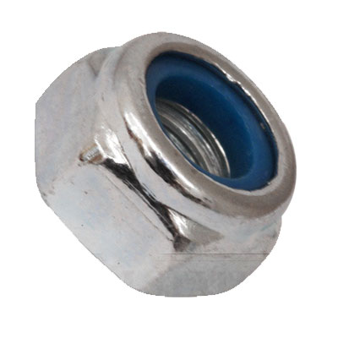
50 Trials to test drift
We set the pipette to about 200 microliters
Dispensed 50 times
Regression Line increased at a small rate
Fix: Replacing the nut with a locking nut

Slide 10
50 trials testing Drift
Mean | 0.195558
Standard Deviation | 0.000639
Percent Standard Deviation | 0.326872

Slide 11
Testing
To test the commercial pipettes against ours we performed 15 trials at various amounts. We set our pipette to the measurements using out eyes, and reset the screw before each trial.
To test the 100-1000uL Pipette against ours we set both pipettes to 200uL
weighed the dispensed liquid in grams
Theoretical weight : 0.1999g
To test the 10-100uL Pipette against ours we set both pipettes to 50uL and to 20uL
weighed the dispensed liquid in grams
Theoretical weight (50uL) = 0.049999g
Theoretical weight (20uL) = 0.019999g

Slide 12
200uL Commercial Pipette vs Test pipette
Trial # | 100uL to 1000uL Micropipette Weight of 200uL of Water dispensed (g) | Test Pipette (1mL Syringe)
 |  | Weight of 200uL of Water dispensed (g)
1 | 0.2028 | 0.1994
2 | 0.2044 | 0.2001
3 | 0.2014 | 0.1997
4 | 0.2004 | 0.1995
5 | 0.201 | 0.1962

Slide 13
50uL Commercial Pipette vs Test pipette
Trial # | 10uL to 100uL Micropipette Weight of 50uL of Water dispensed (g) | Test Pipette (1mL Syringe)
 |  | Weight of 50uL of Water dispensed (g)
1 | 0.0496 | 0.0516
2 | 0.0498 | 0.0514
3 | 0.0498 | 0.0517
4 | 0.05 | 0.0516
5 | 0.0501 | 0.0513

Slide 14
20uL Commercial Pipette vs Test pipette
Trial # | 10uL to 100uL Micropipette Weight of 20uL of Water dispensed (g) | Test Pipette (1mL Syringe)
 |  | Weight of 20uL of Water dispensed (g)
1 | 0.0198 | 0.0195
2 | 0.0196 | 0.0196
3 | 0.02 | 0.0196
4 | 0.02 | 0.0195
5 | 0.0199 | 0.0196

Slide 15
200uL
Commercial pipette
Test pipette
Average of ten trial : 0.20446
Percent Error: 2.233%
Standard Deviation : 0.00291
Percent Standard Deviation: 1.4215%
Average of ten trial : 0.19724
Percent Error: -1.377%
Standard Deviation : 0.00485
Percent Standard Deviation: 2.4588%

Slide 16
50uL
Commercial pipette
Test pipette
Average of ten trial : 0.0499
Percent Error: -0.197%
Standard Deviation : 0.00014
Percent Standard Deviation: 0.2834%
Average of ten trial : 0.05315
Percent Error: 6.303%
Standard Deviation : 0.00195
Percent Standard Deviation: 3.6754%

Slide 17
20uL
Commercial pipette
Test pipette
Average of ten trial : 0.01983
Percent Error: -0.847%
Standard Deviation : 0.00018
Percent Standard Deviation: 0.8911%
Average of ten trial : 0.01921
Percent Error: -3.967%
Standard Deviation : 0.00042
Percent Standard Deviation: 2.1948%

Slide 19
References
Accuracy and Precision. Ft. Belvoir: Defense Technical Information Center, 1967. Web.
"Discover 3D Models." NIH 3D Print Exchange. N.p., n.d. Web. 16 Sept. 2014.

Slide 20
Questions

